Slide 1
Audio Programming
By Jamie Mulvihill
Student Number: 1703169

Slide 2
Dungeon Escape
Simple Maze Game
Player must collect three keys to unlocks door to escape
Enemy is wandering maze trying find player
If player makes too much noise the enemy will chase noise
WASD to move, hold left shift to tip toe
C turns on flashlight

Slide 3
Attempeted Techniques
Recorded own Sounds
Basic Audio Effects in appropriate context
Compressed Audio
Integration with Middleware
Digital Music reacts
Synthesis
Sptialization
Dynamic Audio Techniques

Slide 4
Recorded Sounds
Player:-
Footsteps – Normal, Grass, Water
Death Groan
Flashlight Switch
Enemy:-
Stomps
Roar
Eat – Chomp, Chew and Snap
Attack
Level:-
Atmosphere Sound
Key Jingle
Pick Up Effect
Effects applied to most of these sounds were rendered when generating the soundbank to save CPU

Slide 5
Audio Effects in Game Context
Roomverb – used to replicate sound bouncing off narrow corridor walls
Compressor – used when occluding through walls to soften sounds based on wall type and to create a tip toe effect
Pitch Shifting – used to modify the pitch of a cricket chirp based on distance to player
Low Pass Filter – used in occlusion, low pass frequency controlled based on distance to player
Delay – used to create an echo effect in a more open area than the corridors
Time Stretch- used to control the rate of the Enemy sense/sniff sound, based on distance to player

Slide 6
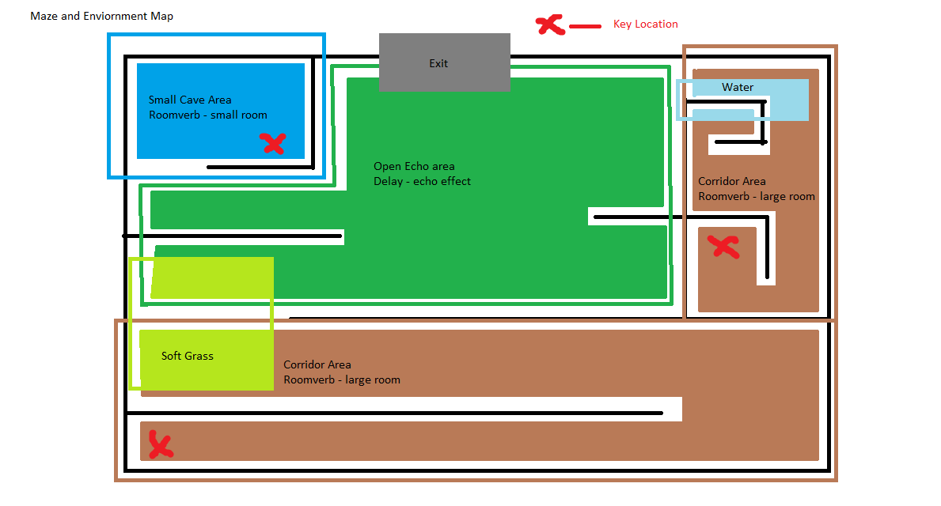
Map of Maze

Slide 7
Compression
Brought all files as uncompressed WAV files to Wwise
Created conversion settings in Wwise
Set conversion format to Opus
PCM is uncompressed, ADPCM loses a lot of quality, Opus is successor to Vorbis, higher audio quality and lower latency rates
Applied settings to all music files and larger in game effect sounds

Slide 8
Integration with Middleware Wwise
Multiple Sound banks, loaded and unloaded through code based on which scene is currently running
Control the Music in game using Wwise States
Use Switches to control the footstep and enemy sounds
The sound sources in the game all make use of game defined auxiliary buses depending on in game environment
Implemented a Wwise stinger for when player finds a pick up

Slide 9
Digital Music
Using Bosca Ceoil a number of different music sequences were created with the purpose of being used to create in game music loops
The in game music that is played is determined by the in game actions and controlled using Wwise States and a coded state machine
The music starts with the “Calm loop” playing, if the enemy detects the player, state changes to the “Chase loop”, when the player has collected all the keys around the map, the state is set to “Escape loop” and if the player wins or loses the state is set as such
To combat listener fatigue, for the Calm, Chase and Escape loops, a base beat sequence is played along with and one sequence from a set of sequences using the random step and sub track functionality in Wwise
A stinger is also used to accent the music when the player collects a Key

Slide 10
Synthesis
Using the Wwise Synth One synthesizer a number of different synthesized sound effects were generated
Using White Noise as a base:
Wind
Enemy Sensing/Sniff
Using Sine Tone as a Base
Cricket Chirp
Wwise effects were then used to shape the sound to the desired effect

Slide 11
Spatialization
Attenuate Sounds based on position and distance to player.
By giving the sound source a position, the sound source is panned correctly so the player can identify the sounds direction
Apply Roomverb when in corridors or cave to simulate sound bouncing between walls and delay when in echo zone to create echoing effect.
Using ray casts to identify if there is a blocking object, if so, the sounds are Occluded.
Sounds that pass through a wall, have a low pass filter and compressor applied to muffle and soften sounds.

Slide 12
Dynamic Audio Techniques
Footsteps of player changes based on surface that is being walked on as well as the player can hold shift to “tip toe”, where a compressor value is applied using an RTPC
The enemy has a sensing sound effect with a time stretch applied to it, the time stretch value is determined by the distance between player and enemy, speeding up the sound as the player gets nearer
Enemy, Key jingle and Cricket chirp sound effects all have a compressor effect applied when they pass through a wall, three different types of wall, the compressor threshold value is controlled with RTPC and set based on the type of wall the sound passes though
Low pass filter frequency for Occlusion is RTPC controlled based on the distance from player to sound source
Game Music is also dynamically controlled by in game events

Slide 13
Reflection
Overall, very satisfied with the project.
Enjoyed and really got into the recording and implementing the in game aspects of the audio.
Having had no knowledge of audio or music before the module, using Wwise really helped to quantify the effects when applying to sound. Giving me a lot more confidence when identifying what type of effect a sound needed to fit the games needs.

